Slide 1
MINING NETFLOW RECORDS FOR HOST BEHAVIORS
Teja Kommineni
Robert Ricci, Kobus van der Merwe and Suresh Venkatasubramanian

Slide 2
Thesis Statement
By combining clustering and other data mining techniques we can produce a view of host behaviors that helps network administrators
to understand behavior of the networks.
This system complements existing network analysis tools to ease network management.
Notes:
Read it and pause for a moment.

Slide 3
Thesis Statement Explained
Hosts
Behaviors (Packets, Bytes, Destinations, Protocols over a time period)
Network Management
Data Mining
Notes:
2) Behavior of a host is an aggregate of the amount of traffic that it sends both in terms of packets and
bytes, the set of destinations it tries to connect to , the set of protocols it uses over some time period.
3) Security, Capacity Planning, Congestion Handling, Quality Of Service, Threat Analysis, IDS, Traffic Classification.
4) There is lot of data to look into.. DM instead of ML is .. you want to find behaviors/patterns a human may have not known to look in first place.

Slide 4
Techniques used by admins
Aggregation by Ports, Protocols, Applications [SolarWinds]
Deep Packet Inspection
Rule Based Systems (IDS)
Notes:
Aggregation on port, protocols, applications, differ from aggregation of host behaviors.
Inspects the actual payload of the packet. It is a fine grain version of above point. What are the sites or urls.
To perform Traffic classification.

Slide 5
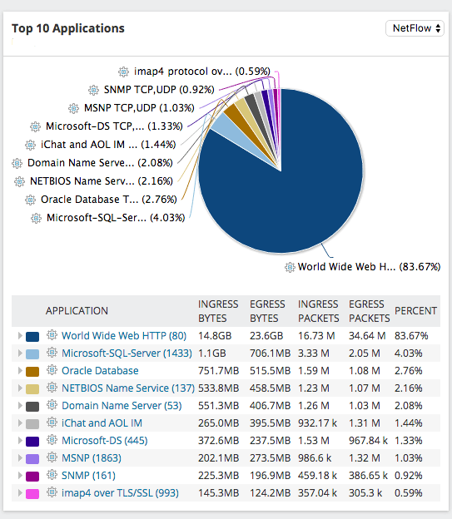
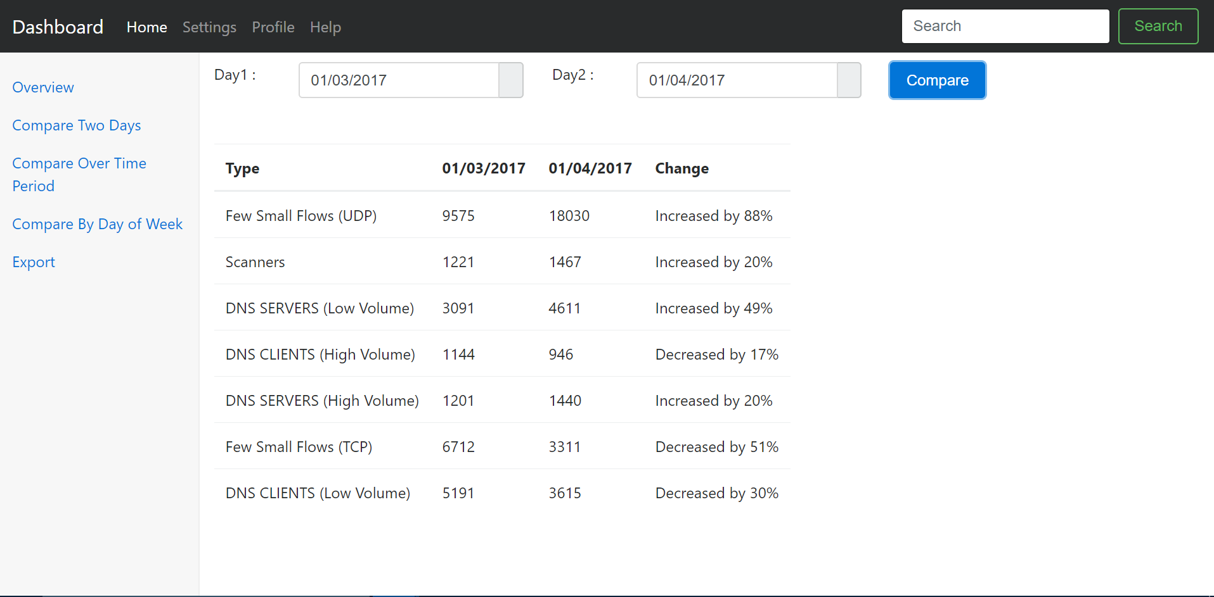
My Contribution
TBD
Notes:
1) Emphasis tone here , point out the different views of data and what we are learning.
2) A major issue in network traffic analysis is classifying and characterizing traffic. Performing an accurate
classification is indeed essential in various respects, such as traffic control, application identification,
defense against attacks, and anomaly detection.
3) However, they are often observed to fail, either because of packet encryption, arbitrary or dynamic port use, or because different protocols or utilizations employ the same single port.

Slide 6
Related Work
Signature Intrusion Detection [Garcia’s]
Machine Learning for Traffic Classification [Andrew and Denis]
Unsupervised approach for Traffic Classification [Jeffrey and Mahanti]
Notes:
Signature based IDS. Signature-based IDS refers to the detection of attacks by looking for specific patterns, such as byte sequences in network traffic, or known malicious instruction sequences used by malware.

Slide 7
Design
GUI
Feature Engineering
Pattern Detector
Anomaly Detectors
Host-Based Split
Capacity
Planning
export
Routers
Implemented
Tools used
export
Applications
NetFlow Collector
Notes:
This is the structure for rest of my talk.

Slide 8
NetFlow Collector
Input Data (Flows)
What is NetFlow?
NetFlow Collectors :
Flow is Inactive or max threshold time
If a TCP flag (FIN / RST) indicates the flow is terminated.
NFDUMP
Notes:
Since, collecting all the packets is tough and infeasible
All packets with the same source/destination IP address, source/destination ports, protocol interface are grouped into a flow.

Slide 9
Data set
Data Source | Emulab Routers
Time Period | Eight Months
Average number of Flows per day | 40 Million
Average number of Hosts per day | 30000

Slide 10
Feature Engineering
Notes:
Feature Engineering is the process of transforming raw data into features that better represent the underlying structure to the models so that they increase the accuracy of the model when applied on unseen data.
Most of the times even simpler models perform better if the features describe the structure
inherent to the data.

Slide 11
Missing Data

Slide 12
Categorical Data

Slide 13
Host Based Split
Feature Scaling
Feature Normalization
Notes:
1) We are defining behavior of a particular host as a vector of different values.
individual flows and a host behavior. 2) Scaling makes no difference to the shape of a distribution.

Slide 14
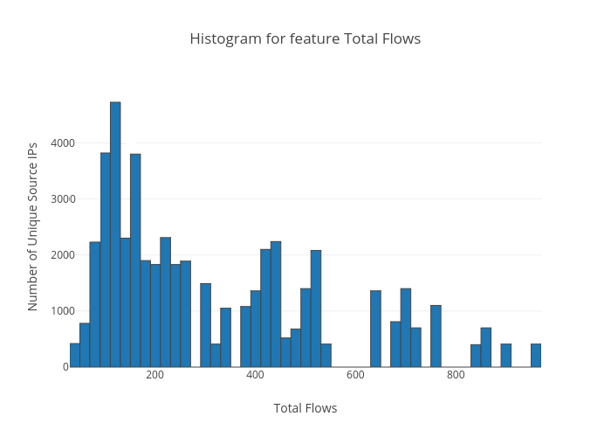
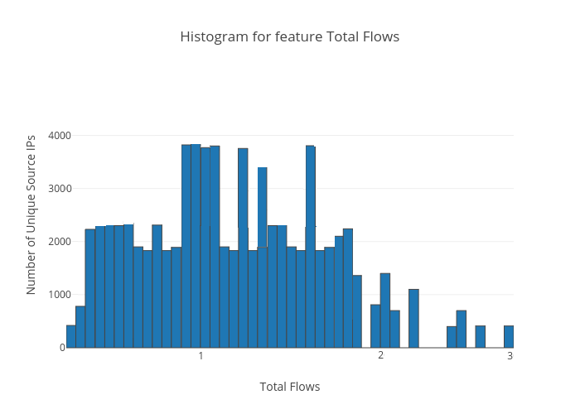
Feature Normalization
Notes:
A transformation may be used to reduce skewness.
Log transformation.

Slide 15
Pattern Detector
Why Unsupervised Learning?
Why Clustering ?
Clustering Models
Why K-Means ?
Notes:
Why a method for K. Because each network data has different k.

Slide 16

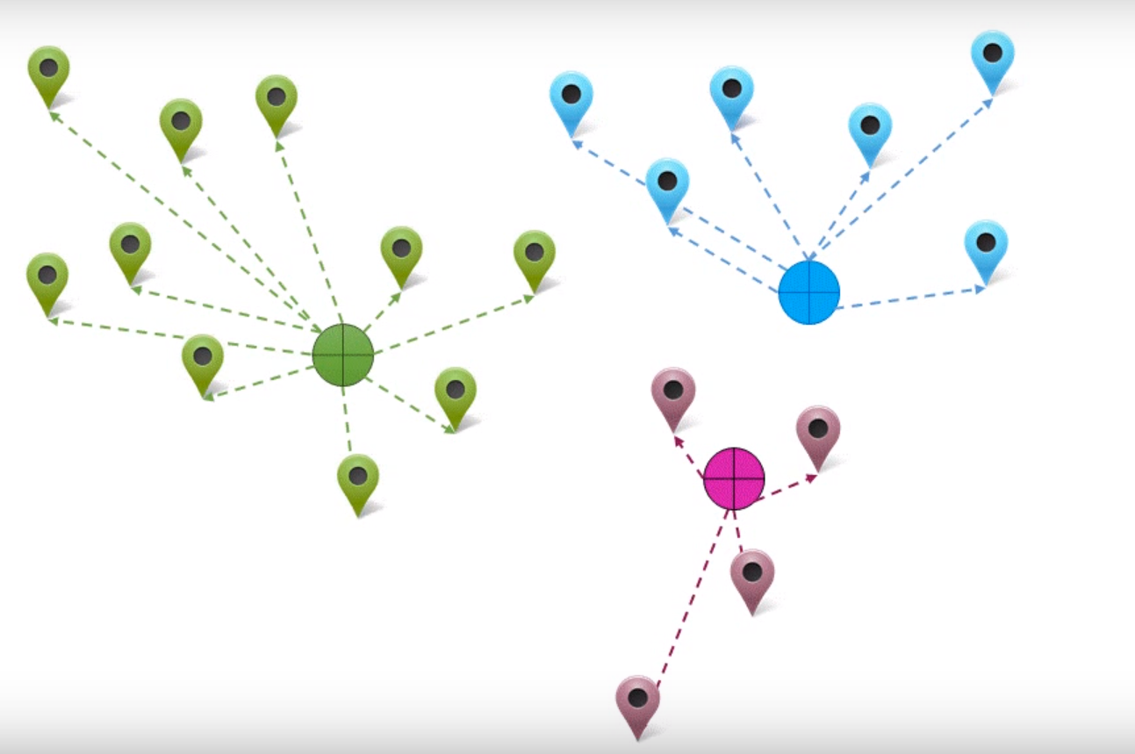
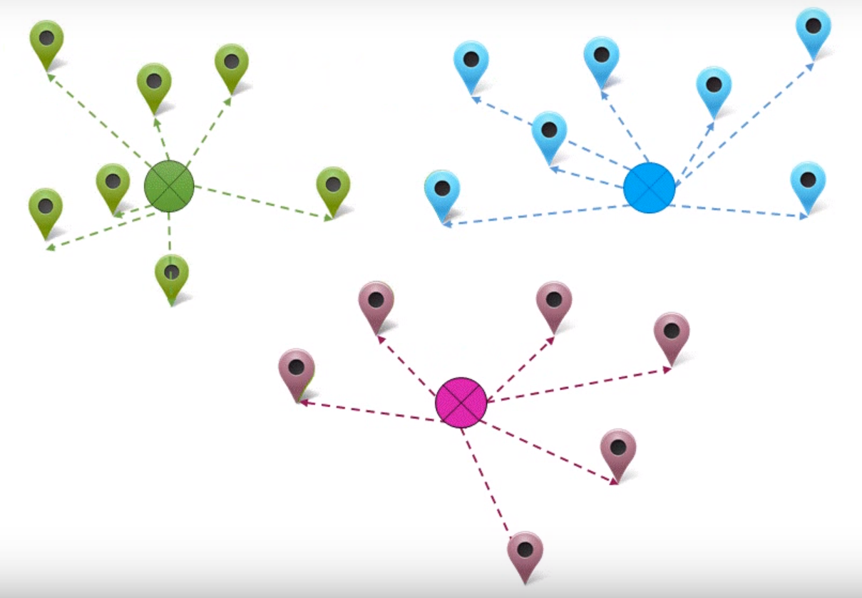
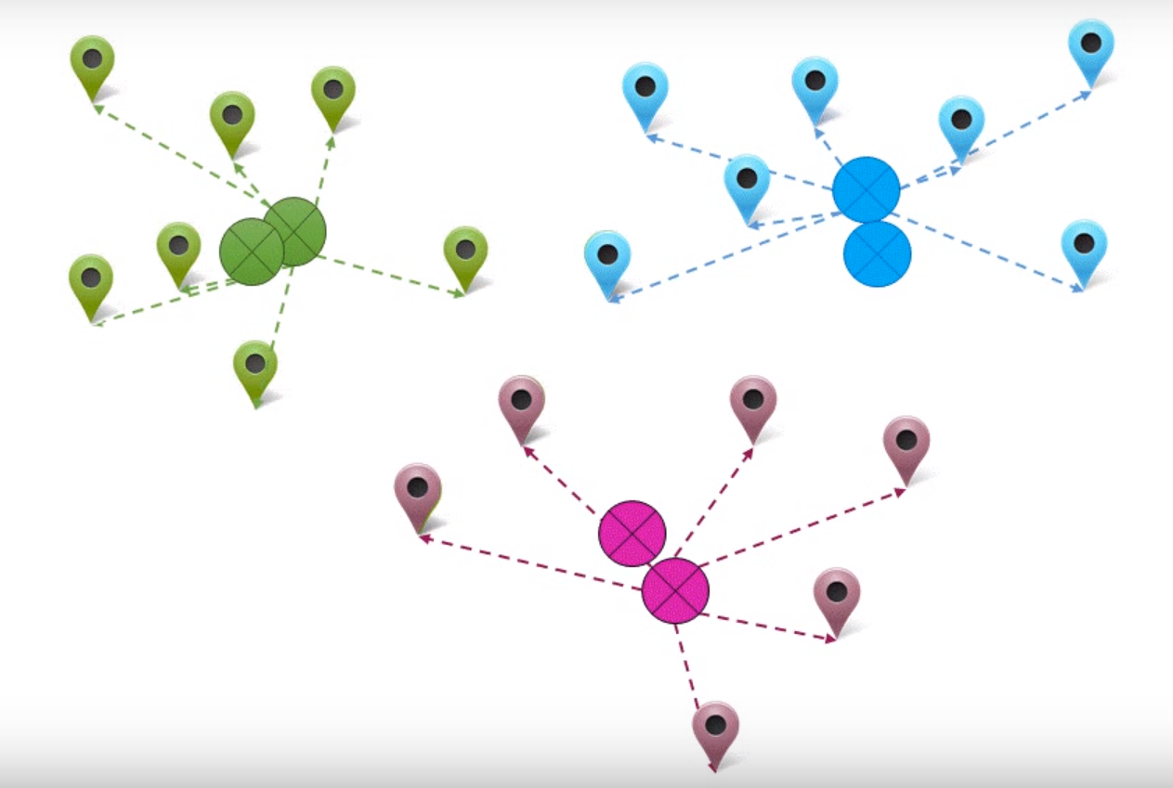
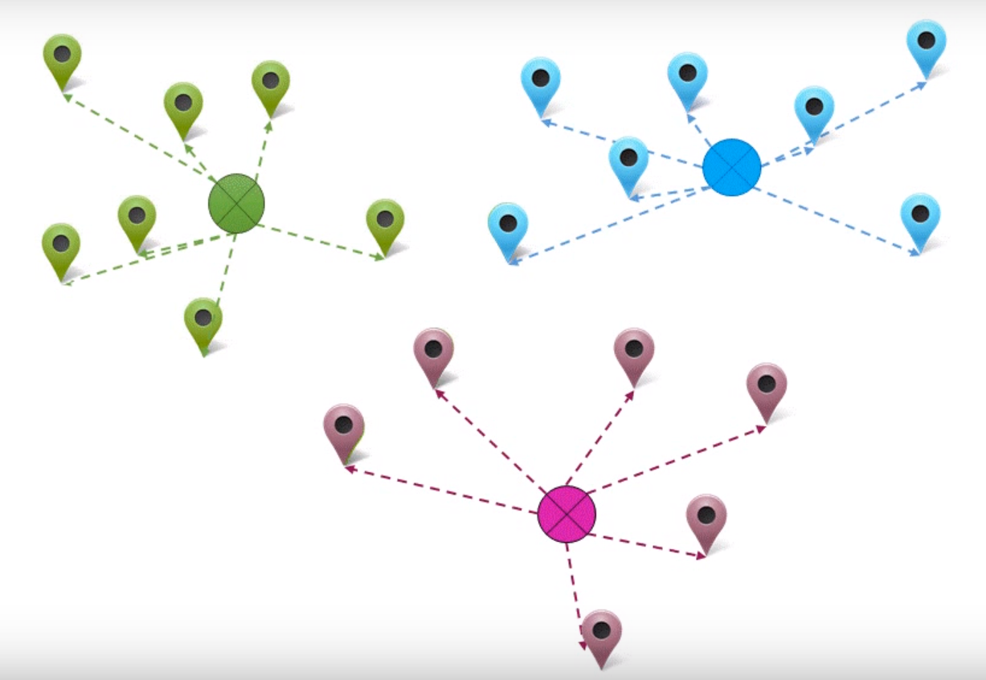
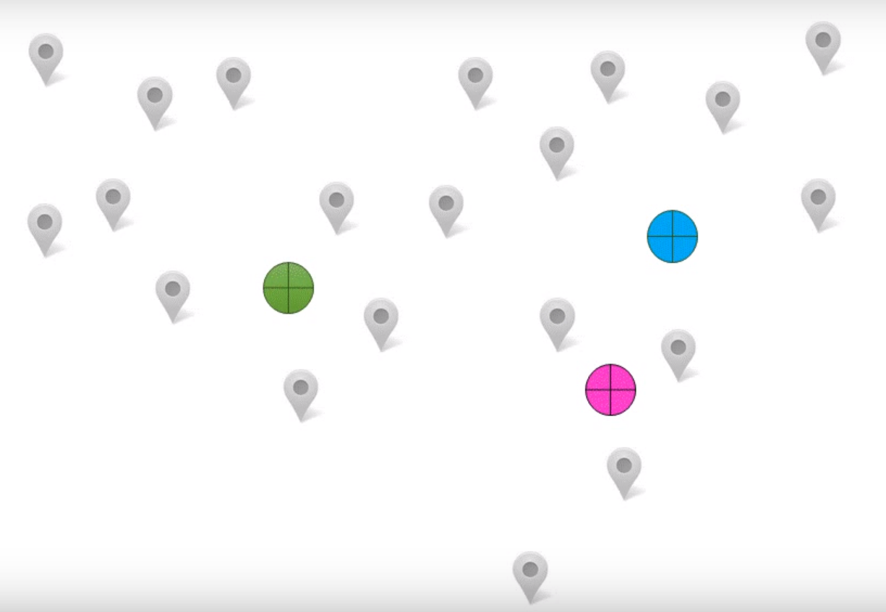
Pattern Detector
K- Means

Slide 17
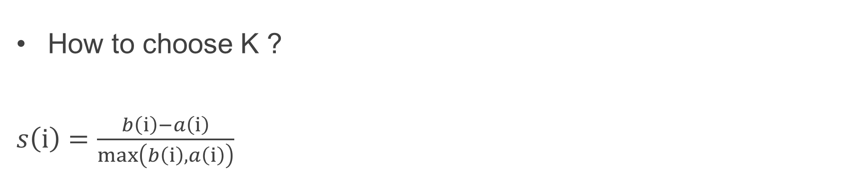
Pattern Detector
How to choose K ?
$s\left(ⅈ\right)=\frac{b\left(\dot{ⅈ}\right)−a\left(ⅈ\right)}{\max\left(b\left(ⅈ\right),a\left(ⅈ\right)\right)}$
Notes:
Why a method for K. Because each network data has different k.

Slide 18
Process Diagram..
K - Means
Reference Day
Label 1
Label 2
NetFlow data shown
as data points in space.
Label 3
Notes:
Process diagram first explain your goal and how we achieve it. Having a set of discrete behaviors. At a human level.

Slide 19
Process Diagram..
K - Means
Reference Day
Label 1
Label 2
NetFlow data shown
as data points in space.
Label 3

Slide 20
Results
Cluster Label | Cluster Centers
 | Avg Flows | Avg Destinations | Avg Source Ports | Avg Destination Ports | Avg TCP | Avg UDP | Avg Bytes
DNS CLIENTS (Low Volume)
DNS CLIENTS (High Volume)
Few Small Flows (TCP)
Few Small Flows (UDP)
DNS SERVERS (High Volume)
DNS SERVERS (Low Volume)
Scanners | 97
Notes:
Scanners.
DNS Servers High Volume , they are less in number but lot of DNS traffic.
DNS Servers Low Volume , also contain web traffic along with them.
Few Small Flows, Normal TCP information exchange.
Interesting to see UDP flows also.

Slide 21
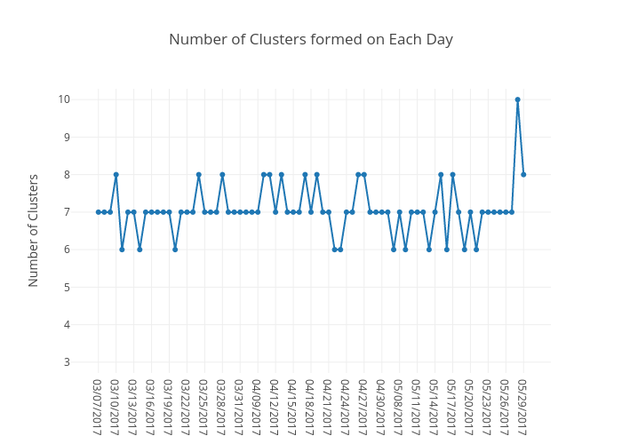
Results

Slide 22
Results

Slide 23
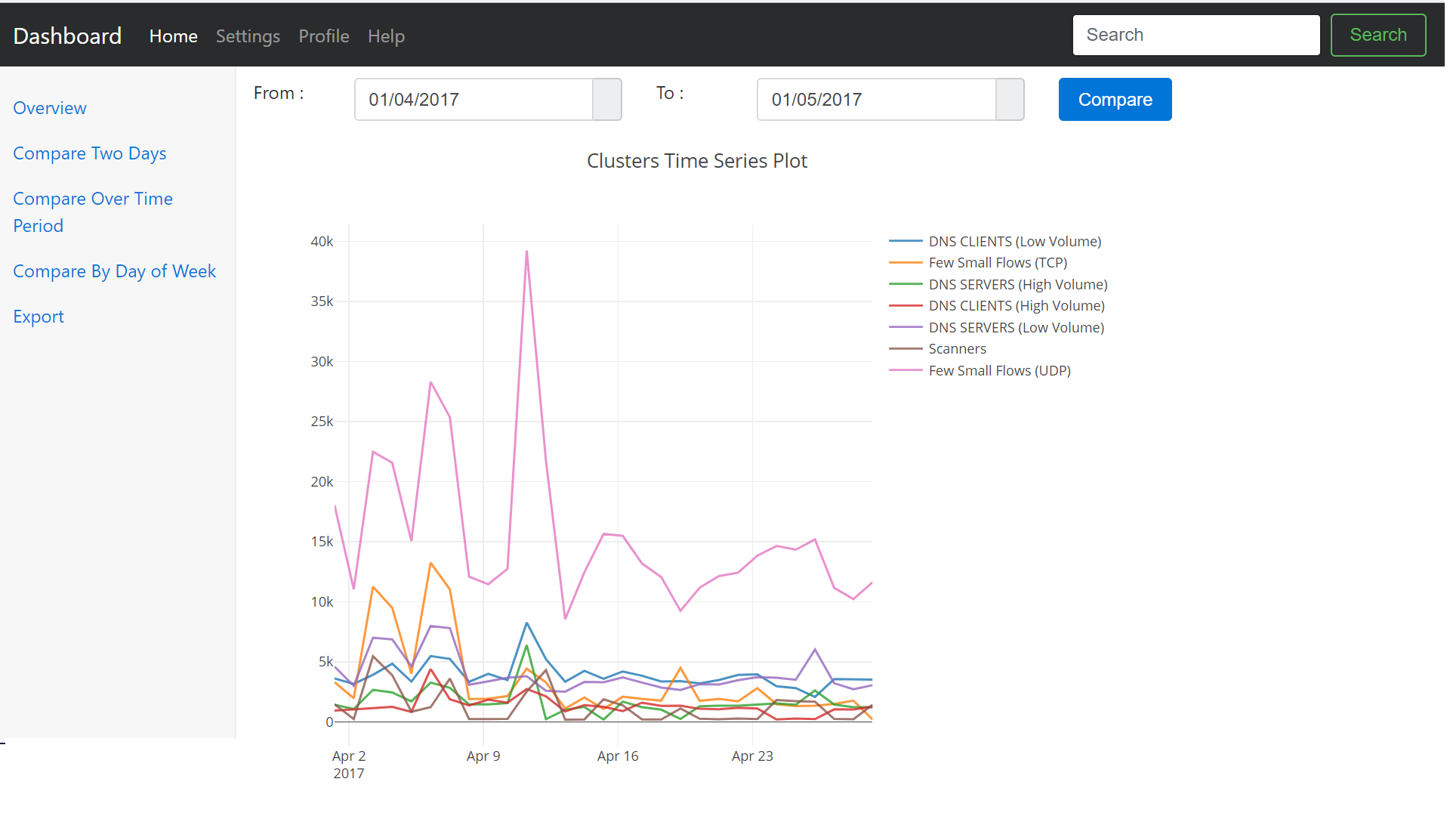
Results

Slide 24
Evaluations
University NetFlow Data | Extract behaviors from real world data
Synthesize NetFlow data | The Netflow data which we receive doesn’t have any ground truth and hence we choose behaviors of interest to network admins and synthesize NetFlow data to represent these behaviors.
2 – clusters | To verify our systems basic functionality by supplying Synthesized NetFlow data where the hosts exhibit two unique behaviors.
N – clusters | To verify how our system performs in an environment with multiple networks and with millions of hosts.
Security | To verify if our system finds the behaviors that affect the security of network.
Detection Rate | To compare the detection rate of (anomalous behavior in the network) our system with existing tools like snort, Security Onion.
Use cases | To ascertain the reasons for real time use cases such as Congestion and Capacity Planning through our system.

Slide 25
To do..
Temporal Clustering
Simulating Data
Evaluations
Writing Thesis

Slide 26
Questions
“By combining clustering we can produce a view of host behaviors that helps network administrators
to understand behavior of the networks.”

Slide 27
THANK YOU

